Slide 1
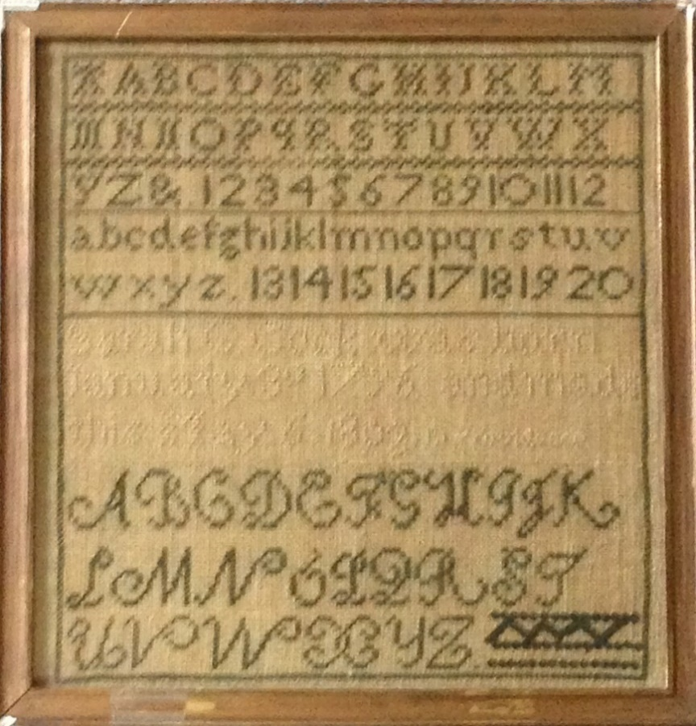
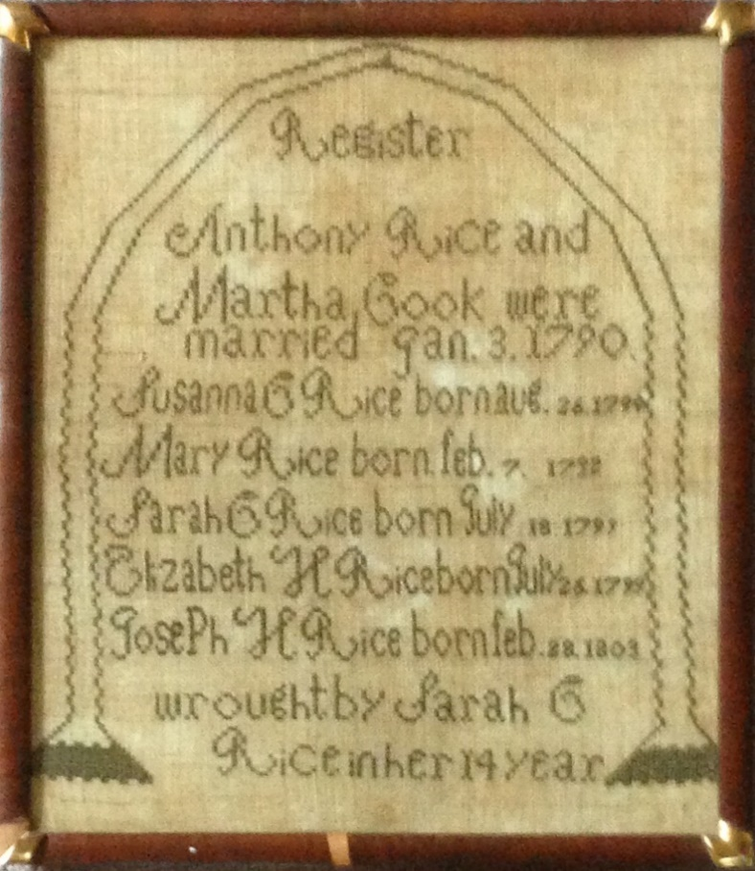
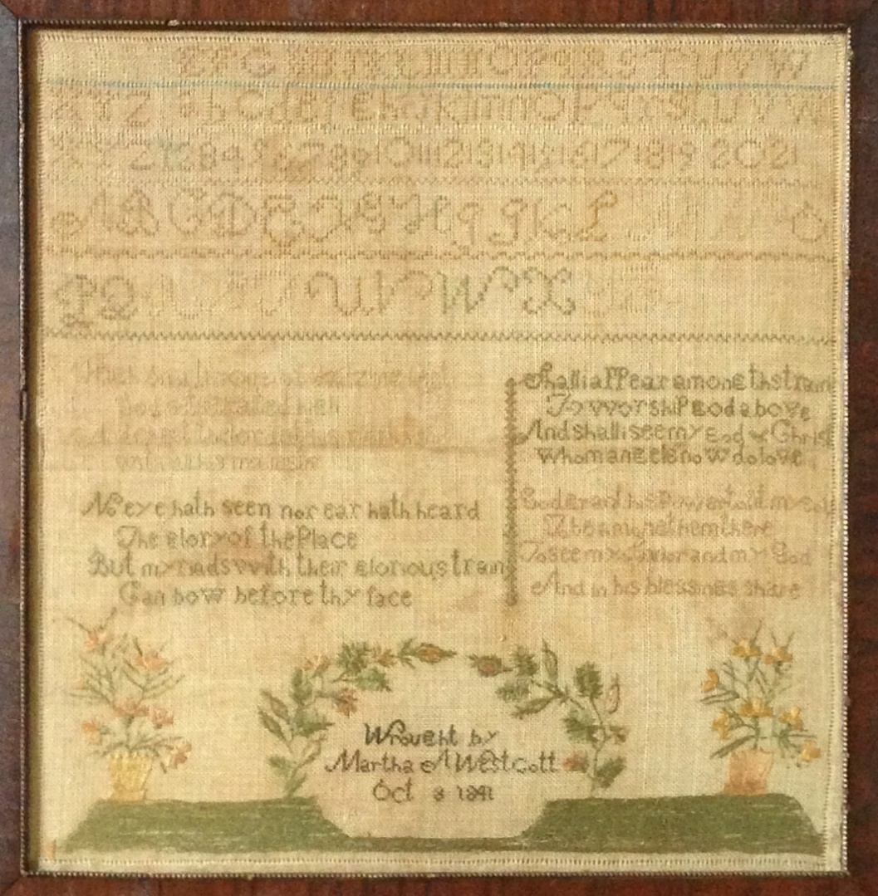
Three Samplers from Westcott, Rhode Island
Notes:
Thank you for opportunity to display some artifacts from the Westcott Society Collection and tell you the story of Three Samplers and a place called Westcott.
So, two questions. First, by show of hands who has made sampler or has one in your home? Any men?
And, again by show of hands, how many of you have ever been to Westcott, R.I.?

Slide 2
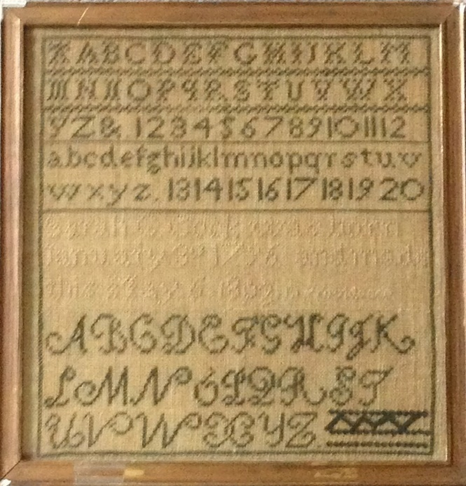
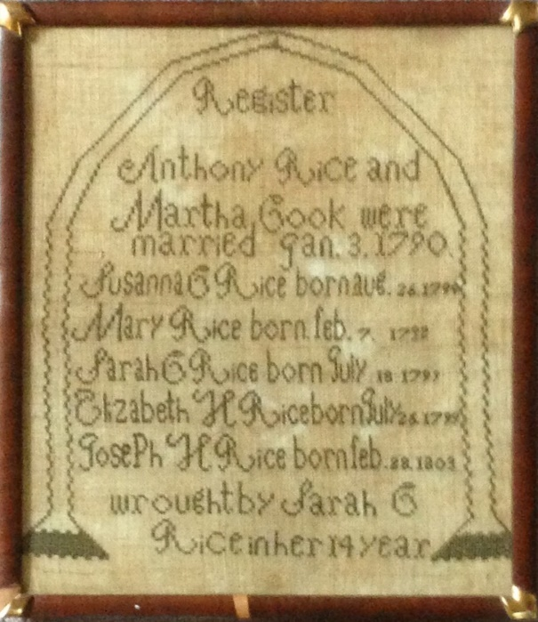
Three Samplers from Westcott, Rhode Island
David Wescott Smith Society of Stukely Westcott Descendants of America
Notes:
My name is David Smith and I am the historian for the Society of Stukely Westcott Descendants of America.
No, there is not a typo in my middle name. In the Smith clan, the center T was lost three generations ago.
Now a few things about my seven-times great grandfather and the society named after him.

Slide 3
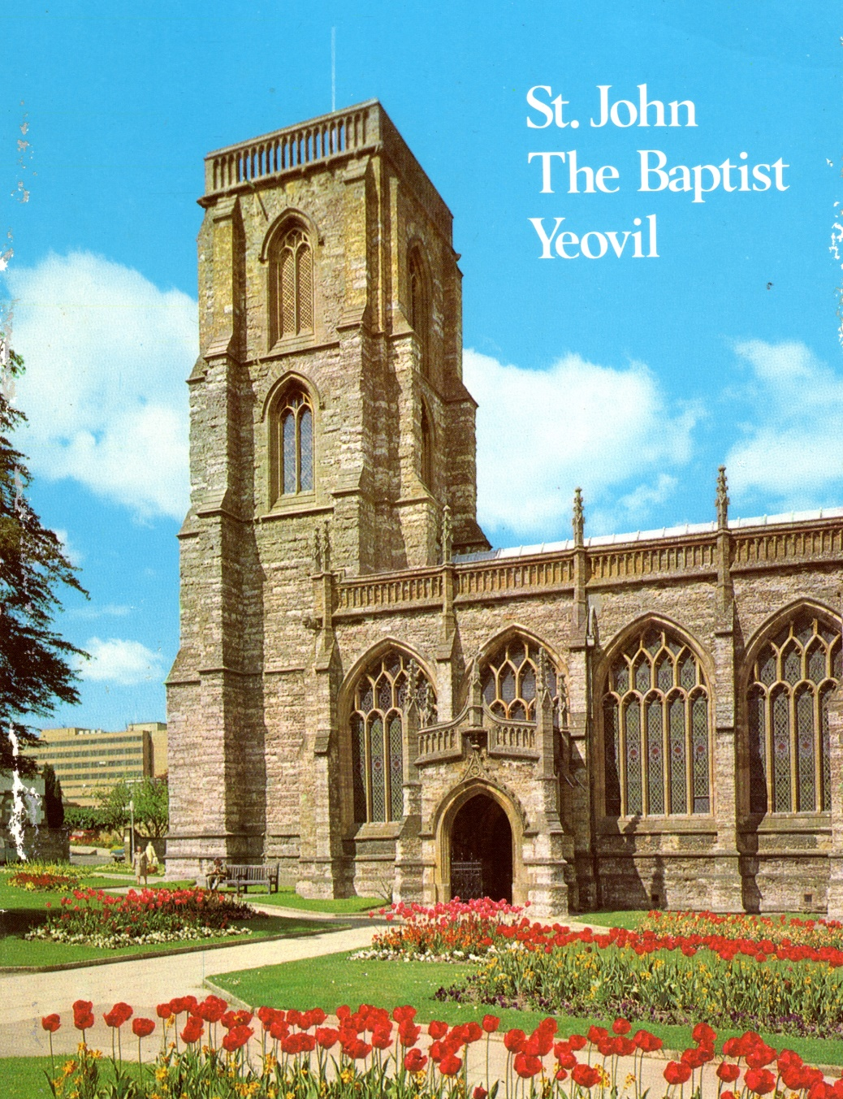
Stukely Westcott (1592-1678)
1592: Born Somersetshire, England
1619: Marries Juliana Marchant, St. John the Baptist Church, Yeovil
Notes:
Stukely Westcott was born in Somersetshire, England in 1592.
On October 5, 1619, he got lucky and married Juliana Marchant at St. John the Baptist Church in Yeovil, Somerset, England.

Slide 4
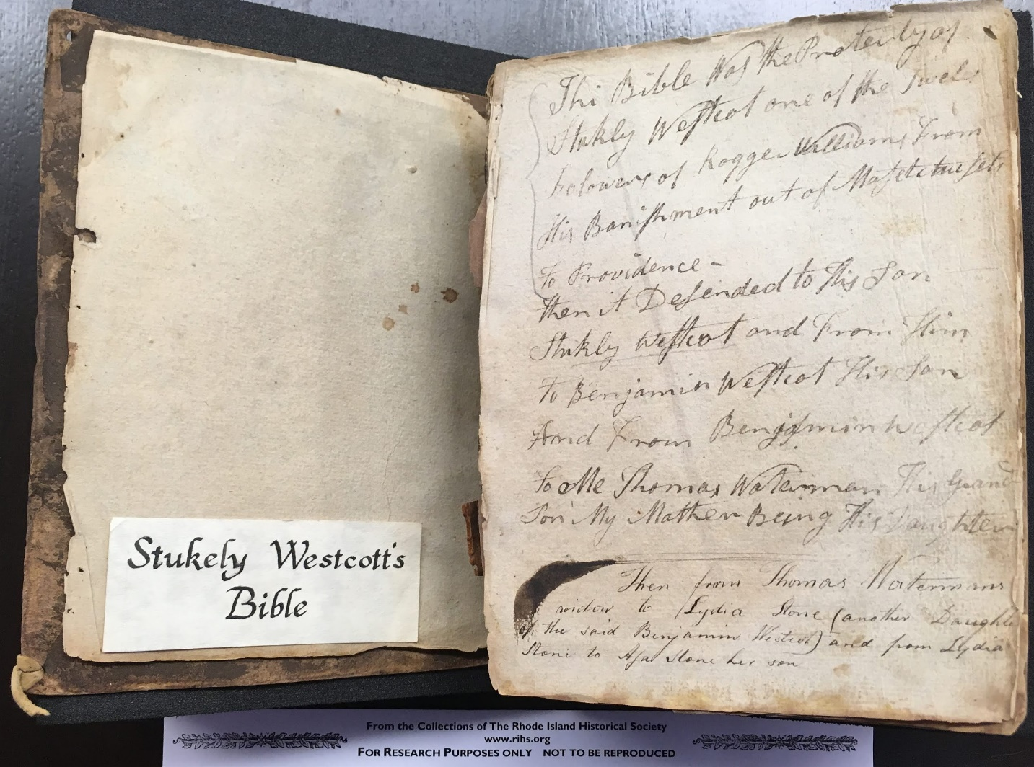
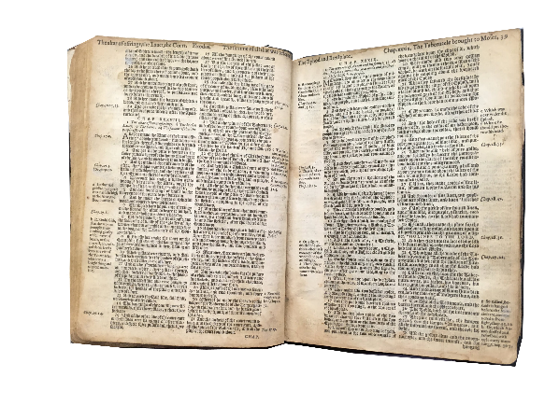
Stukely Westcott (1592-1678)
1592: Born Somersetshire, England
1619: Marries Juliana Marchant, St. John the Baptist Church, Yeovil
1635: Sails from Dartmouth; joins John and Mary Sweet in Salem
Notes:
In 1635, Stukely and Juliana sailed for the New World from Dartmouth with their six children, the oldest of which as 14-year old Damaris.
Also, on board was William Arnold and family, including son Benedict who would marry Damaris in 1640. Nothing like a North Atlantic cruise to spark a romance (or arranged marriage).
Based on events over the next several years, we can presume that Stukely and Juliana left, among other reasons, to find religious freedom. We know that Stukely was both literate and religious. His bible is in the collection of the Rhode Island Historical Society.
The first stop for the Westcotts was Salem where Stukely’s sister Mary and her husband John Sweet were followers of Roger Williams. Stukely was a Freeman in Salem in 1636, with a town lot and a share of a meadow and march land.

Slide 5
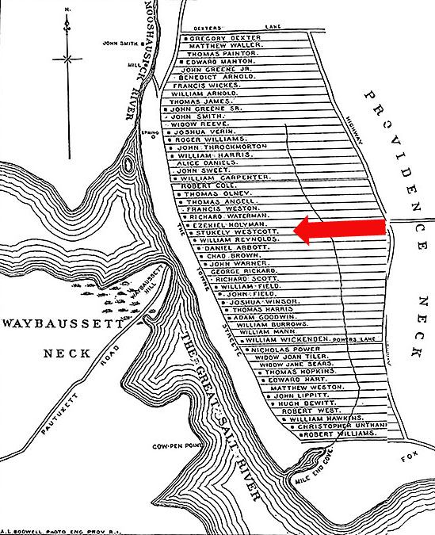
Stukely Westcott (1592-1678)
1592: Born Somersetshire, England
1619: Marries Juliana Marchant, St. John the Baptist Church, Yeovil
1635: Sails from Dartmouth; joins John and Mary Sweet in Salem
1638: Follows Williams to Providence: Baptized, Proprietor
Notes:
In 1638 Stukely joined Williams in Providence as one of the original 13 proprietors of the city. The map of the early settlers of Providence shows their five acre lots along the Towne Street (now North and South Main Street and the Highway (now Hope Street). The Westcotts are smack in the middle, property now covered by portions of the Providence County Courthouse, RISD and Brown.
Shortly after his arrival in Providence, Stukely was re-baptized by Rogers Williams, and thus was an original member of the First Baptist Church in America.

Slide 6
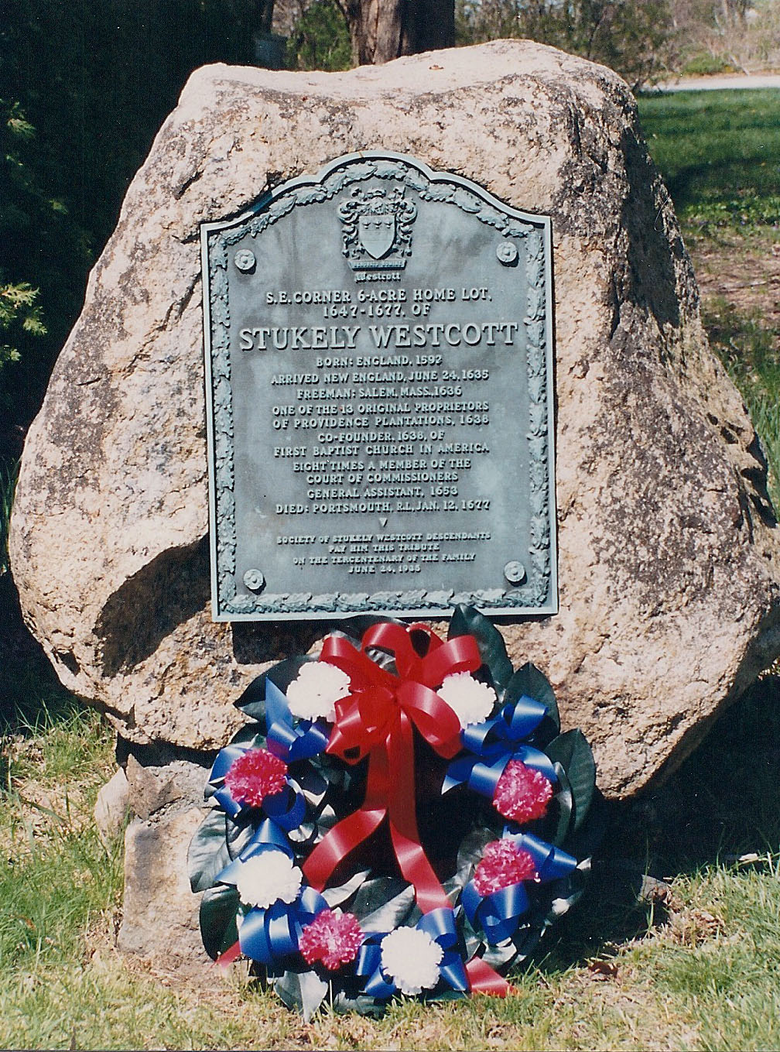
Stukely Westcott (1592-1678)
1592: Born Somersetshire, England
1619: Marries Juliana Marchant, St. John the Baptist Church, Yeovil
1635: Sails from Dartmouth; joins John and Mary Sweet in Salem
1638: Follows Williams to Providence: Baptized, Proprietor
1644: Received Purchaser in Shawomet
1678: Dies in Portsmouth
Notes:
Stukely would later join Samuel Gorton, John Green, Randall Holden, Ezekiel Holliman and other Received Purchasers in the Shawomet settlement south of the Pawtuxet River, which would be renamed Warwick when Gorton secured a charter from the crown in 1646. A plaque placed on West Shore Road near Sandy Lane in Warwick marks the location of Westcotts’ 6-acre plot in Olde Warwick.
In the Summer of 1648, Stukely, William Arnold, John Green and nine others formed a church in Warwick along the lines of the Providence congregation. Juliana is said to enforce adherence to principles of their faith such as adult baptism for anyone to continue in the extended family.
The family fled Warwick before it was burned in retaliation for the Great Swamp Massacre. Stukely died in Portsmouth in 1678, but his body was later buried in the first burial ground in Warwick which, several years earlier, Stukely and others had laid out along Sandy Lane behind the Westcott home.

Slide 7
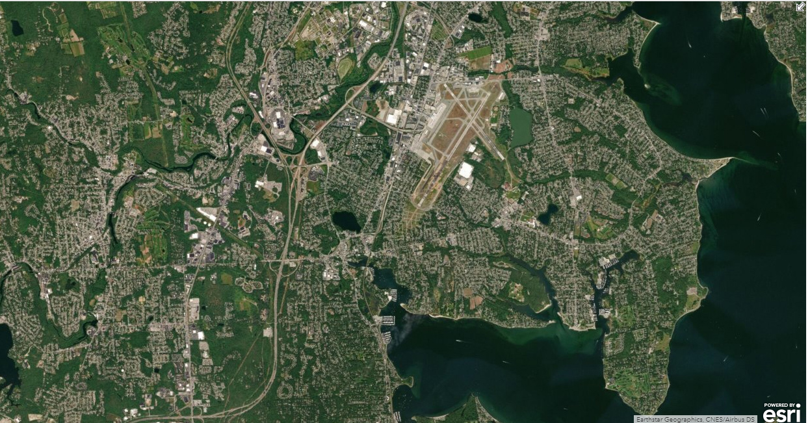
Olde Warwick
Township
Line
Notes:
As part of the Shawomet deal, the original settlers – the Seventeen Men -- received a six-acre plot near the bay. As additional lots were sold in the township, that is east of the yellow line on the map, they quickly recouped their initial investment. The purchasers parcels of land from Narragansett Bay to the Connecticut border.
For example, Stukely received grazing and lumber rights in Hillsgrove, a little something on Warwick Neck and on Pottowamut, access to Greenwich Bay, 200 acre plot in Cowesset Farms, 420 Acres straddling bald Hill Road, and eight different locations in Coventry totaling 1,200 acres. That’s nice work for just showing up. We’ll come back to one of those grants later.

Slide 8
Toskeunke
Meadow
Natick Farms
400 Acre Lots
Hillsgrove
Timber Rights
Olde Warwick
Township
Line
Wecochaconet
400 acre lots
Warwick Neck Grazing Rights
Cowesset Farms 200 Acre Lots
Chipowisset
Potowamut
Notes:
Stukely and Juliana’s son Samuel died while the family was in Salem, but the five other children survived long enough to marry and begin populating colony. Initially, the descendants settled in the Township and along the Pawtuxet River, in the Narragansett Country and what is now the west side of Cranston. But after the Revolutionary War, many migrated west along Interstate 90 to settle upstate New York and the Western Reserve, and then along National Road in Ohio to Indiana, Illinois and Iowa, and by the beginning of the Twentieth Century throughout the country.

Slide 9
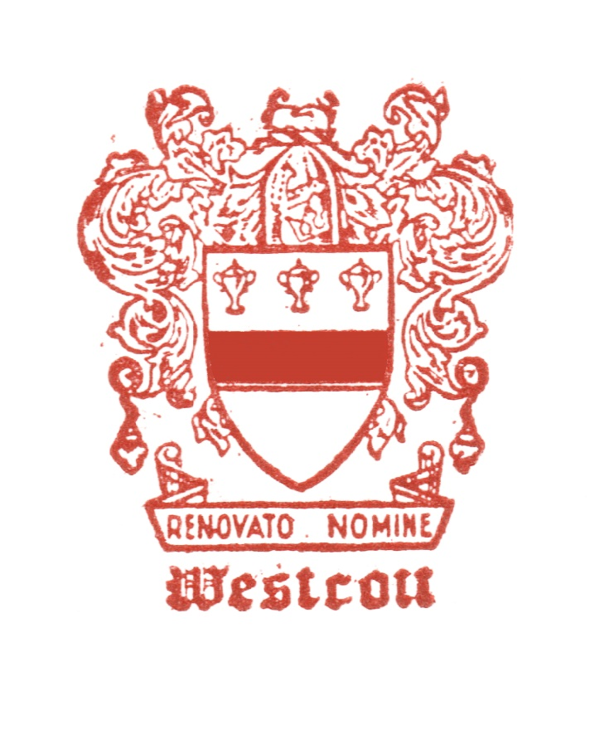
Notes:
A reunion of some Westcotts in Madison Township, New York in 1934 developed into the Society of Stukely Westcott Descendants of America, which held its first meeting in 1935, a week-long event that took place in Salem and Providence. That’s the clan assembled in Salem with some reenactors from the Salem Historical Society.

Slide 10
Notes:
Remarkably the organization has continued and grow.
Last June we met in Carmel, Indiana for our 42nd biennial meeting.

Slide 11
Know Your Kindred
Barlow Westcott, b. 1920
Notes:
Cousin Barlow Westcott was at the meeting in 1935 and celebrated his 98th birthday on the way to the Indiana meeting y attending a Cardinals game at Busch Stadium.
Like other family organization, as we seek to “Know Our Kindred,” we naturally focus on the political and military leaders among our kin (General Benedict Arnold, excepted) and various Westcott inventions and products. The brand includes:

Slide 12
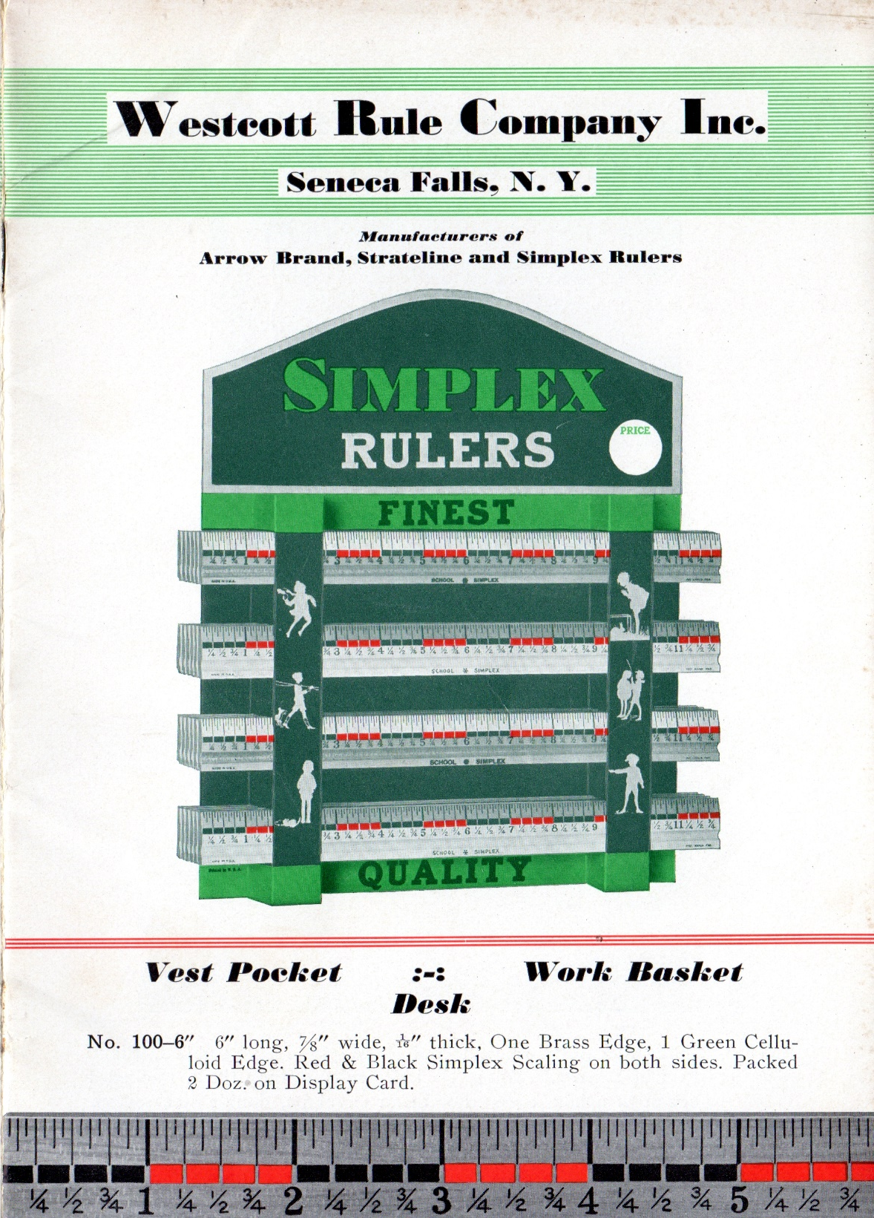
Notes:
The Westcott Ruler that helps every school child measure up

Slide 13
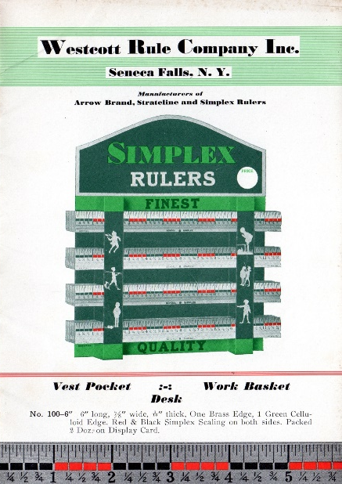
Notes:
The knuckle-saving Westcott Wrench

Slide 14
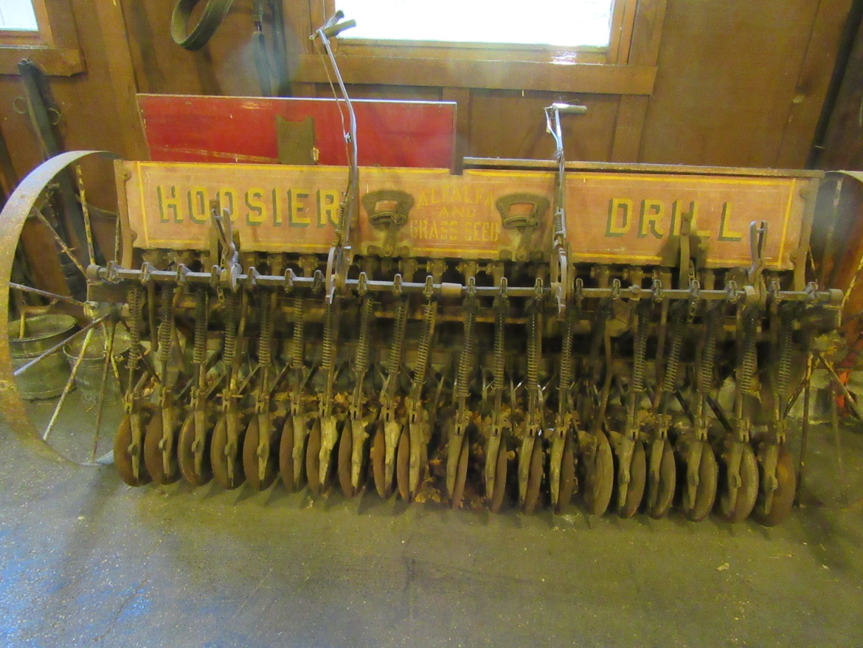
Notes:
There’s John McMahon Westcott’s agricultural innovations such as the Hoosier Drill

Slide 15
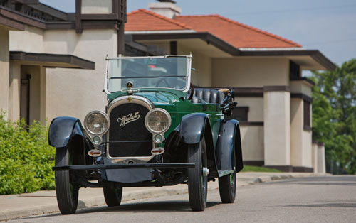
Notes:
And the Westcott Touring Car, heralded in a 1915 ad as “The last car you’ll ever need.”

Slide 16
Notes:
But recently I have become distracted by the work of three little-known teenagers, whose handiwork endures as a testimony to their skill, literacy and faith. They are three samplers in the Westcott Collection at the Warwick Historical Society, the first of which was stitched by Sara Crawford Cook in 1808.

Slide 17
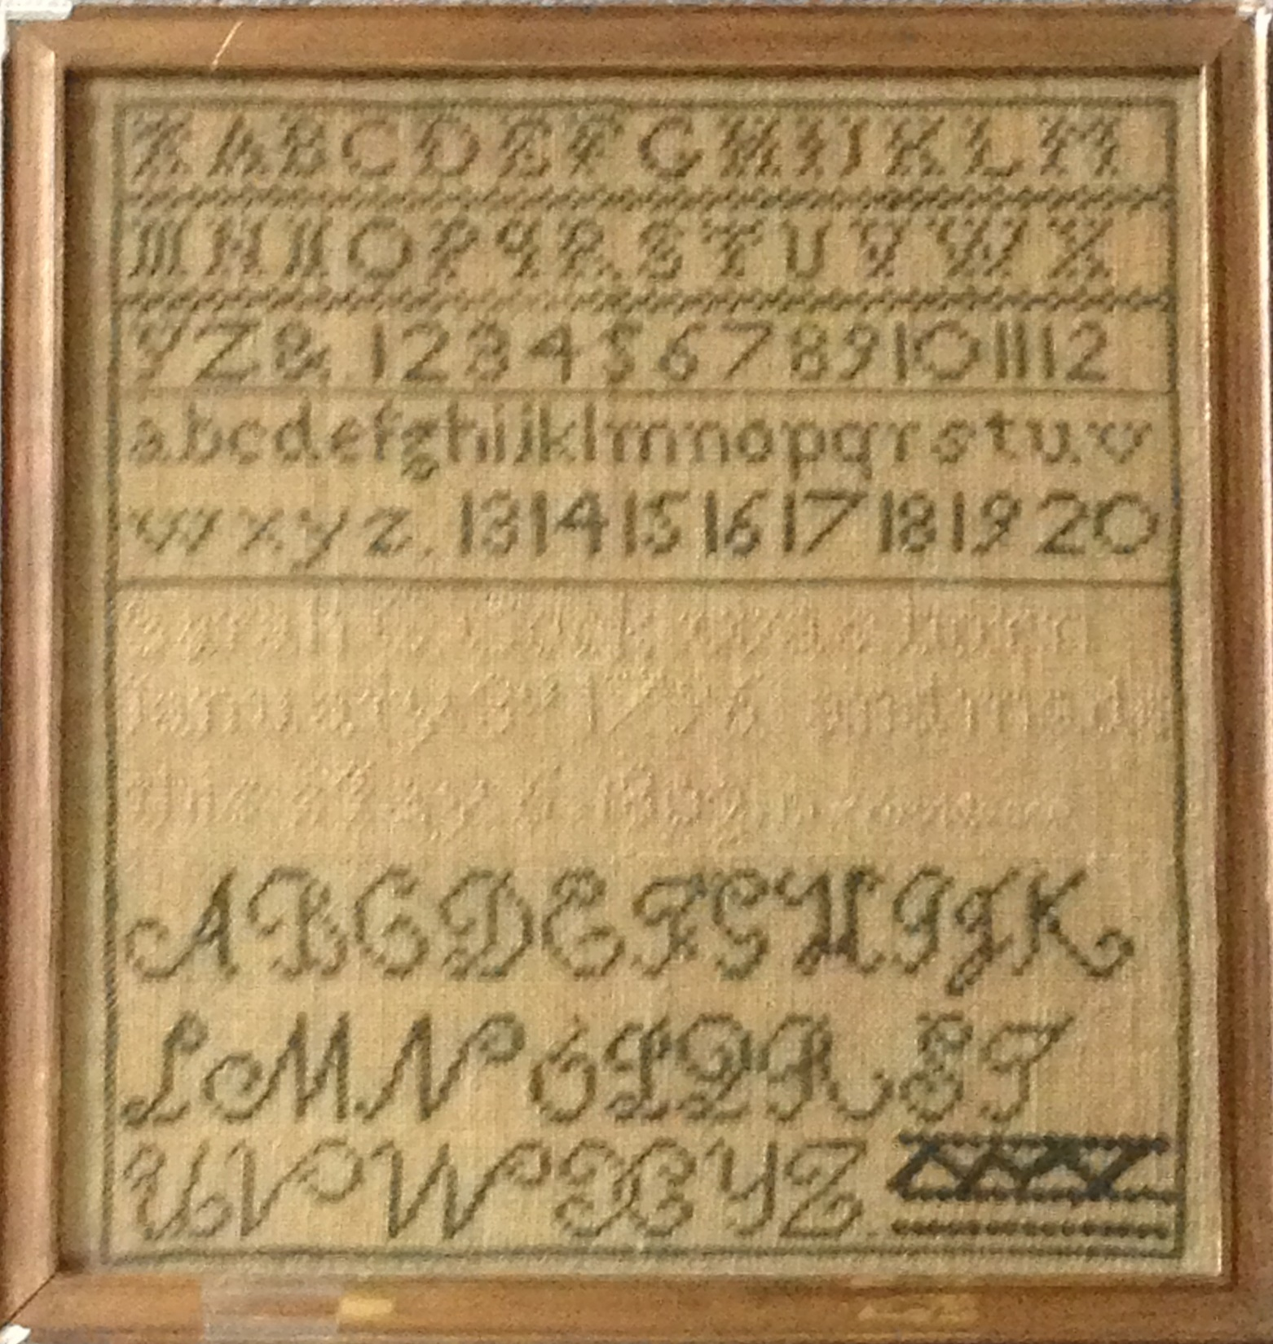
Sarah Cook,
Letters and Numbers,
1808
Notes:
A sampler is an embroidery meant for display, usually made by stitching a series of X’s to form letters and numbers and then moving on to more freehand needlework for decoration.
The earliest known American sampler was made by Loara Standish of the Plymouth Colony about 1645. The sampler was an educational tool in the 18th and 19th centuries and stitching one was something of a standardized test for a young girl, a demonstration of her mastery of letters, numbers and needlework, all skills helpful in running a household.

Slide 18
Sarah Cook,
Letters and Numbers,
1808
Notes:
Sarah Cook follows a very common layout of three horizontal areas, or bands. In the first band she renders capital letters in block type, followed by numerals, punctuation marks and lower-case letters. The work is left to right, top to bottom, very steady and precise, and complete. She even hits the control key to stitch condensed versions of the capital A, M and N.
In the bottom band, Sarah renders her letters in cursive and fills the space at the end of the last row with a sawtooth design. Well, the judges gave her 9’s and 10’s for execution, maybe less for degree of difficulty and expression.

Slide 19
Sarah Cook,
Letters and Numbers,
1808
Age 12
Sarah C. Cook was born 30 January 1796 and made
this May 6, 1808.
Notes:
But let’s not be too harsh. The faded middle band reads:
“Sarah C. Cook was born 30 January 1796 and made this May 6, 1808.”
Amazing work for a twelve-year-old.
So, what do we know about Sarah?

Slide 20
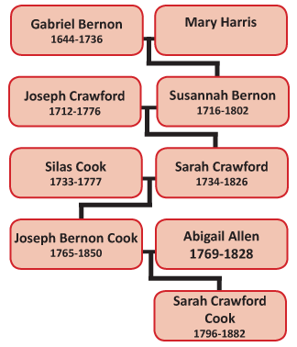
Notes:
She was the daughter of Joseph Bernon Cook and Abagail Allen. Joseph Cook was a sea captain who was captured by the British Navy during the war of 1812. But after the hostilities, he continued as a ship’s master and did quite well for himself.
Sarah was also the great-great-granddaughter of Gabriel Bernon, a well-to-do merchant and an ardent Huguenot who fled France in 1686 and supported Huguenot settlements in Massachusetts and Rhode Island, but who was also responsible for establishing the first three Episcopal Churches in Rhode Island. We will return later to find out what became of Sarah.

Slide 21
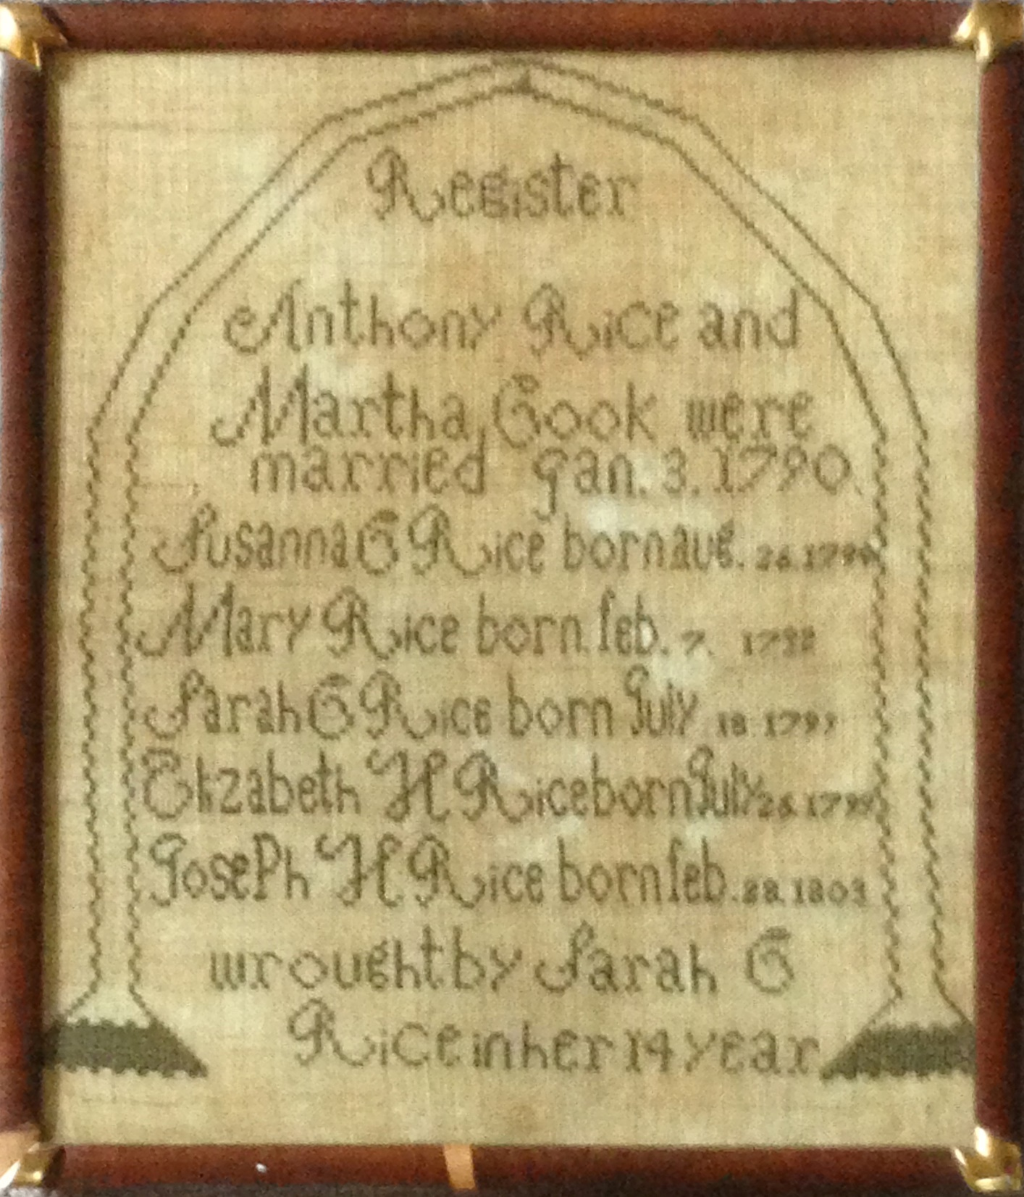
Sarah Rice
Register, 1808
Age 13
wrought by Sarah C
Rice in her 14 year
Notes:
But first we will look at the work of her 13-year old cousin, Sarah Crawford Rice. “Register,” wrought by Sarah C Rice in her 14 year documents the marriage of her parents, Anthony Rice and Martha Cook (sister of Joseph Bernon Cook), and the births of their five children. The family history is rendered in cursive lettering of different sizes within a simple arch. The work is not as tight as cousin Sarah’s, but it’s filled with names and dates, and -- for a genealogist -- what’s not to love about Register.

Slide 22
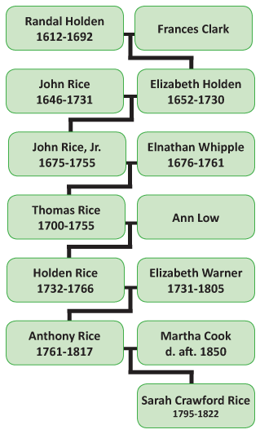
Notes:
Sarah’s father Anthony Rice was a Revolutionary War soldier who served at Bunker Hill and in the Battle of Rhode Island. Anthony was the three-times great-grandson of Randall Holden, one of those original Warwick Received Purchasers who divvied up the northern half of Kent County.
His father was Holden Rice, another sea captain, but one not as fortunate as Joseph Cook. Holden was lost at sea in 1766.

Slide 23
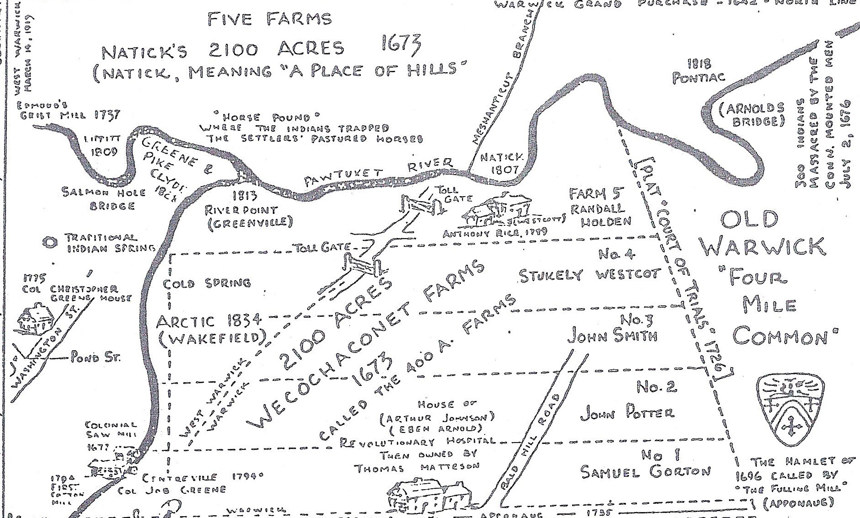
Notes:
Anthony’s feet were firmly on dry land in one of Randall Holden’s parcels.
The map shows the Wecochaconet Farms, 2,100 acres between the Pawtuxet River to the north and Centerville Road to the south divided in five farms:
1 went to Samuel Gorton
2 to John Potter
3 to John Smith (not my John Smith)
4 to Stukely Westcott.

Slide 24
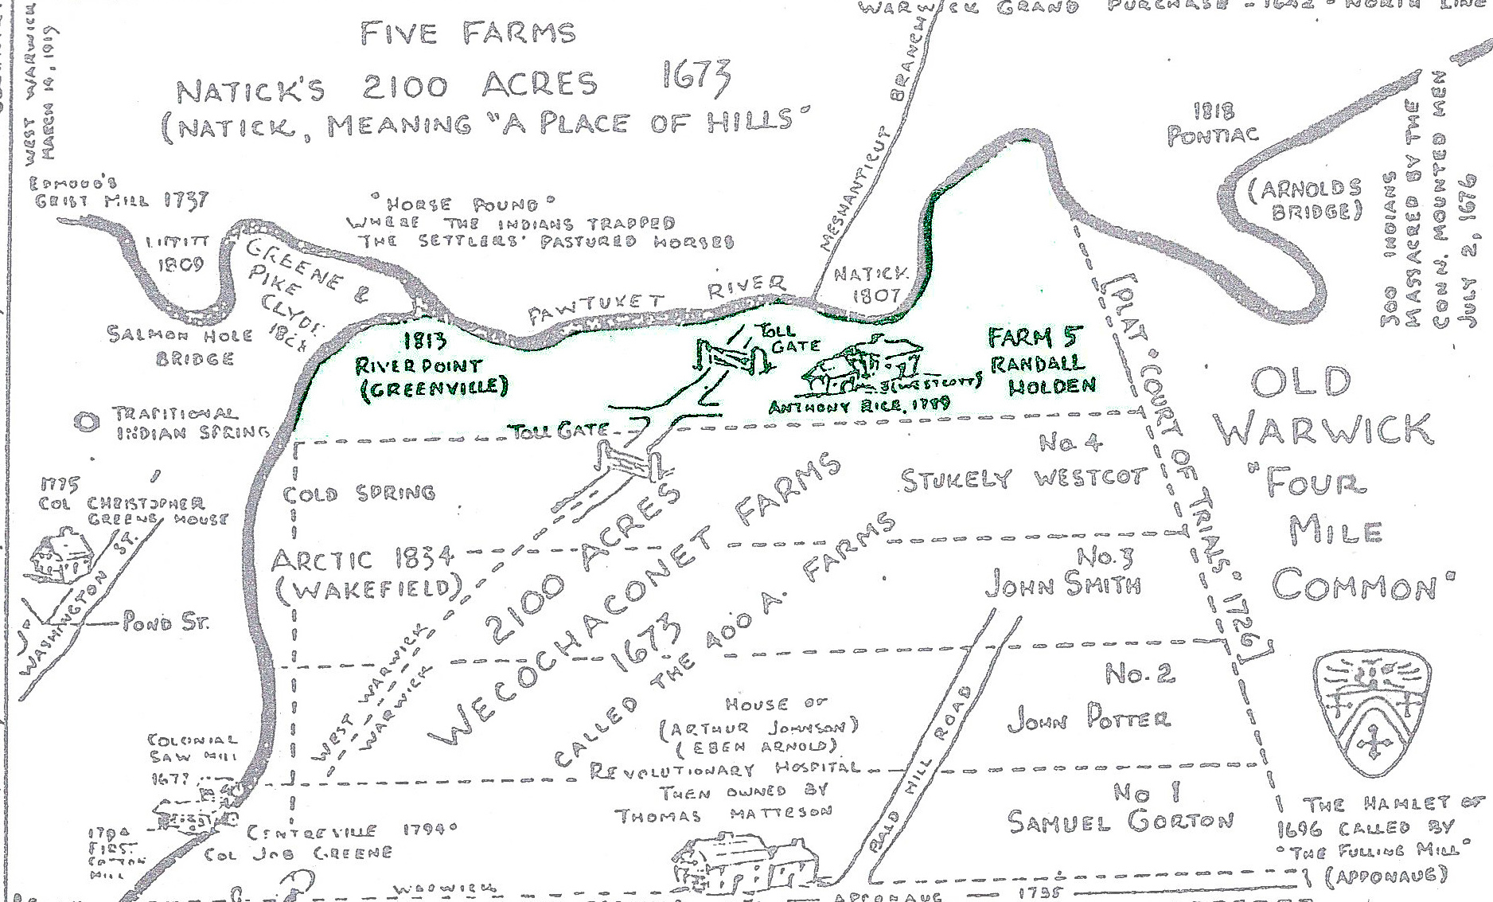
Notes:
And Randall Holden received Number 5, 420 acres along the river, an area that now contains parts of the CCRI campus, the Rhode Island Mall and the Clicquot Club bottling plant in East Natick.
Anthony Rice had a farm in the southwest corner of his 3-times great father’s Farm Number 5. In 1789 Anthony built a post and beam, center-chimney Cape, with five rooms downstairs and two rooms upstairs. The house faced south toward Compton about a mile away along a bridle path.

Slide 25
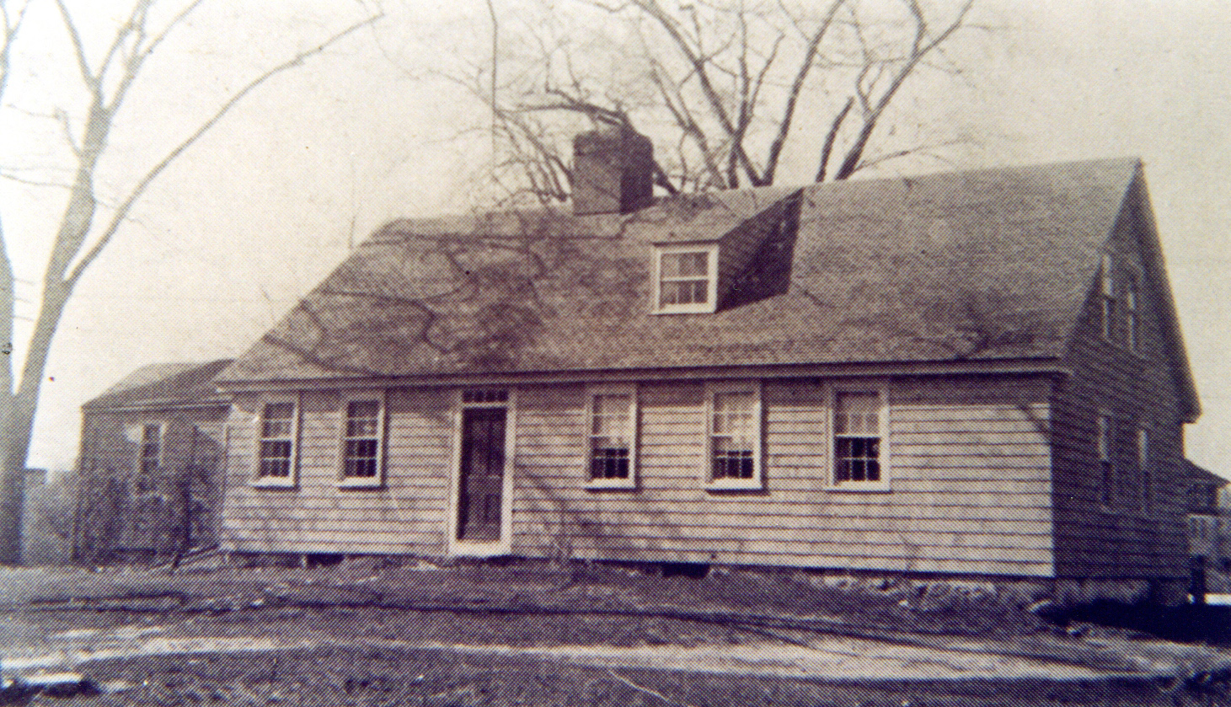
Notes:
There was a lot going on during the time Sarah Rice was stitching her sampler. Samuel Slater and Moses Brown’s success in Pawtucket with industrial espionage and manufacturing technology caught on quickly with folks in the Pawtuxet River Valley, and mills and mill villages sprang up throughout the valley. But while the power of water drove down the cost of manufacturing, getting raw materials and shipping finished goods were cumbersome and costly.

Slide 26
Notes:
The first solution was toll roads such as the New London Turnpike in 1817 (the year Anthony died), which ran right behind the Rice home, where it would connect to mills to the west via Providence Street and to Apponaug via Toll Gate Road.

Slide 27
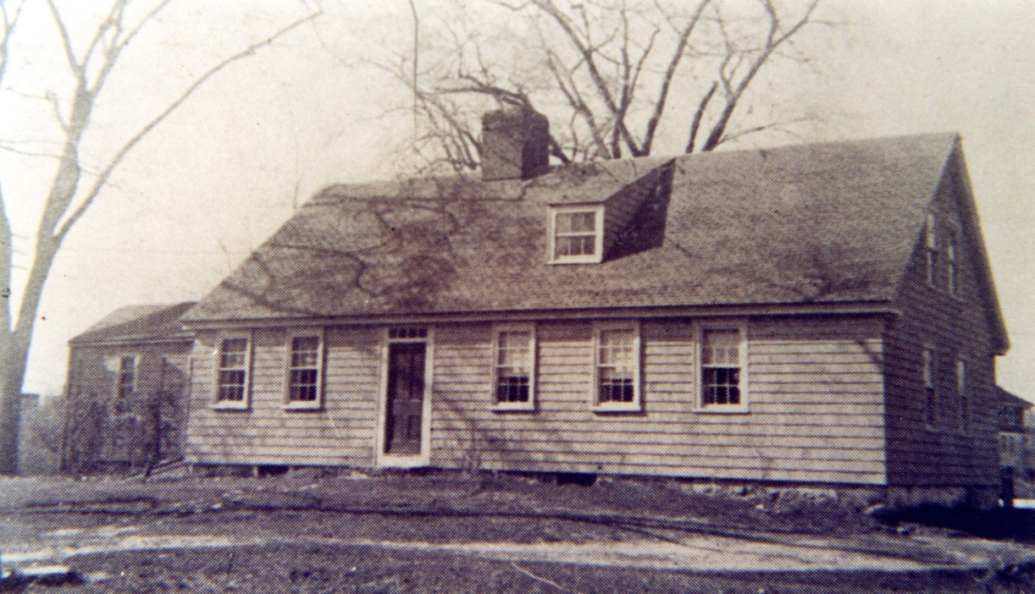
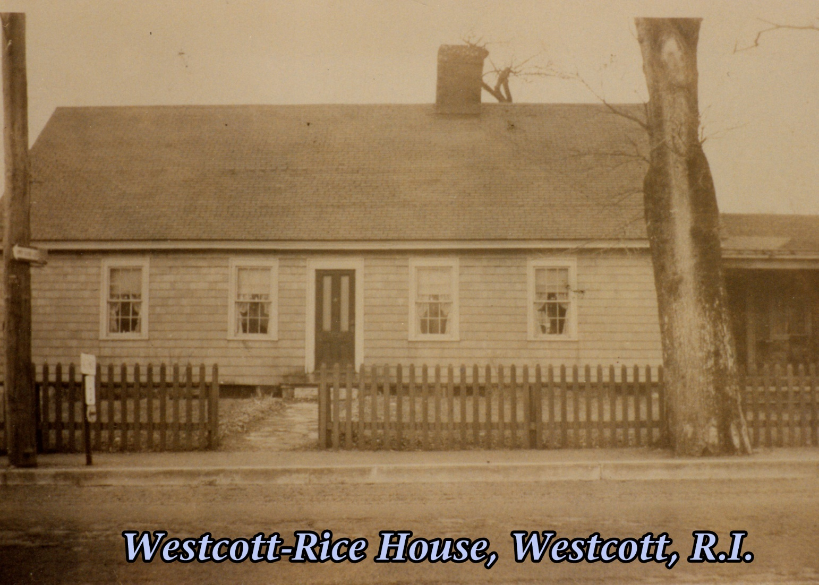
Notes:
The north side of the house became the front along the new road.
A 2-room toll house and a gate to be re-attached were moved from Centerville and placed across the new road from the Rice home. And family members were charged with turning the pike, that is, opening the gate, once they had collected the authorized fee.

Slide 28
Notes:
When she was 19, Sarah Rice married Major John Westcott, member of the Kentish Guard, and a harness maker and cobbler. He was the son of General Thomas Westcott and the three-times great grandson of Stukely.
Their marriage and the births of their four children are recorded in John Westcott’s bible, pages of which are part of the display.

Slide 29
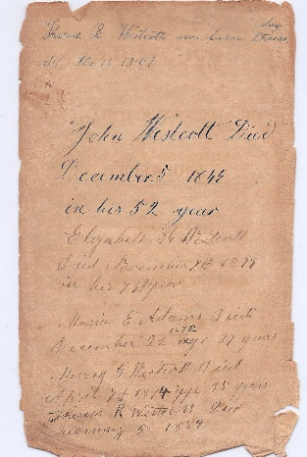
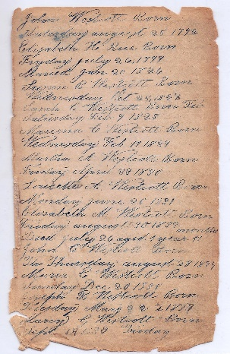
Notes:
Sarah died on April 18, 1822.
On January 20, 1825, John married Sarah’s younger sister Elizabeth Holden Rice. John and his four children moved in with Elizabeth in the Rice family home across from the toll house. John set up shop in one of the two rooms of the toll house. The house Anthony Rice built would soon become known as the Westcott House.
In addition to making shoes and collecting tolls, the Major and Elizabeth Holden Rice were populating Rhode Island. The fourth of their 12 children was Martha Westcott, the maker of the third sampler in the collection.
We don’t know whether Martha ever collected tolls as the development of the Stonington Railroad made the turnpike obsolete by the late 1830s.

Slide 30
Martha Westcott
Eye Has Not Seen
1841, Age 11
Notes:
Martha Westcott was 11 years old when she stitched a multi-colored three-band sampler with alphabet and numerals in the top band, a four-stanza hymn based on 1 Corinthians in the center and floral decorations surrounding her signature in the bottom band. It reads “Wrought by Martha Westcott Oct 8 1841.”
Martha’s is the largest (18 in. by 19 in.) and the most complex of the three.
The composition is enclosed in a pulled thread border.
The first and fourth stanzas are faded, but the hymn is still dechiperable:
High on a throne of amazing hegt {sic} God sat exalted high And great the Lord at his right hand With all his majesty

Slide 31
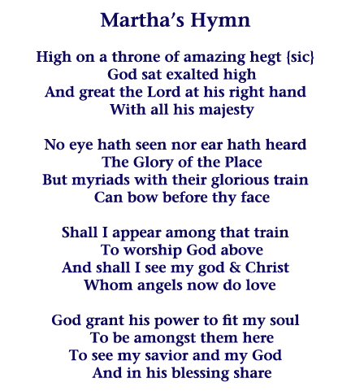
Notes:
No eye hath seen nor ear hath heard
The Glory of the Place But myriads with their glorious train Can bow before thy face
Shall I appear among that train To worship God above And shall I see my god & Christ Whom angels now do love
God grant his power to fit my soul To be amongst them here To see my savior and my God And in his blessing share
I don’t know the source of the four stanzas. Perhaps it is a published hymn. But until someone opens the hymnal, I will continue to believe that Martha wrote the poem she stitched.

Slide 32
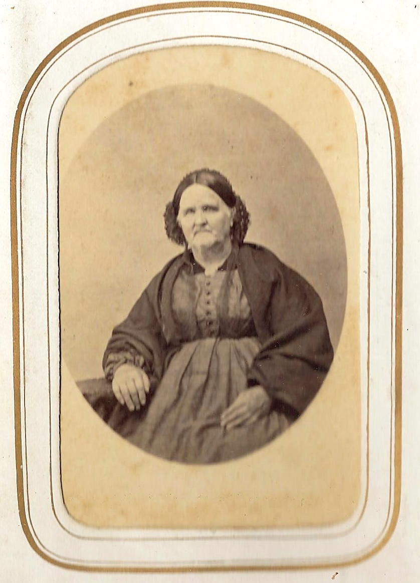
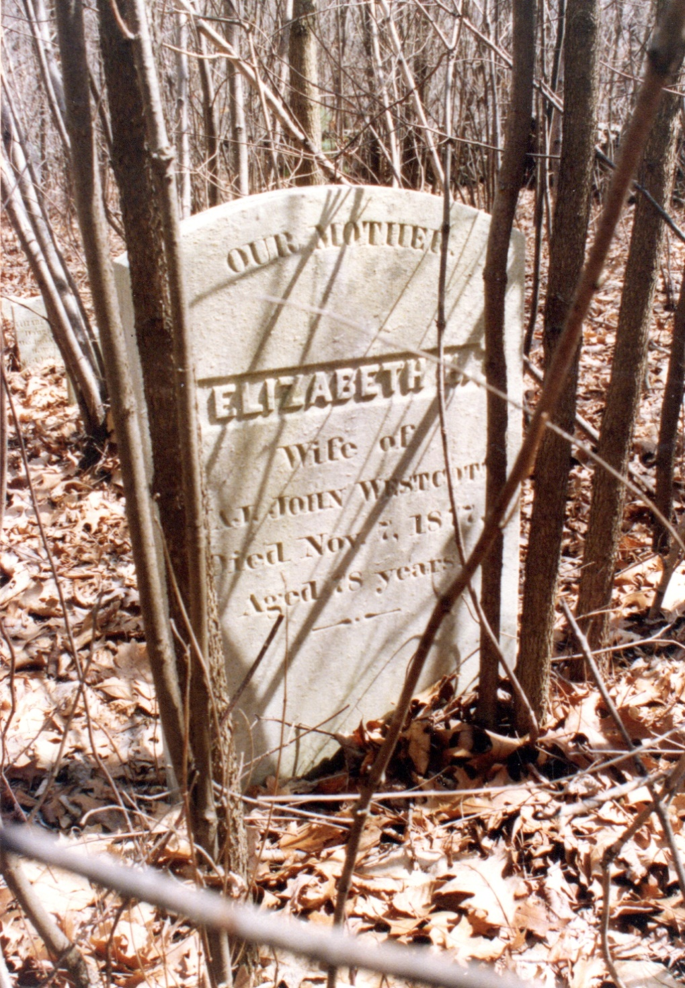
Notes:
Major John Westcott died in 1844 and was buried in the General Thomas Westcott Lot (WK 125), on a hill just to west of the Westcott-Rice home.
In the 1850 Federal Census, widow Elizabeth is listed as the head of household along with 10 Wescott children. Twenty-year-old Martha’s occupation is, not surprisingly, “dressmaker.”
This is a picture of Elizabeth, mother of 12, stepmother of four. In his will, Captain Joseph Bernon Cook named Elizabeth the guardian of his daughter Sarah Cook, the maker of the first sampler. Elizabeth was tasked “to use her best endeavors to see that my daughter is well and comfortably maintained during her life.”
In 1877 Elizabeth left the brood behind and was buried in the General Thomas Westcott Lot along with the Major and her sister.

Slide 33
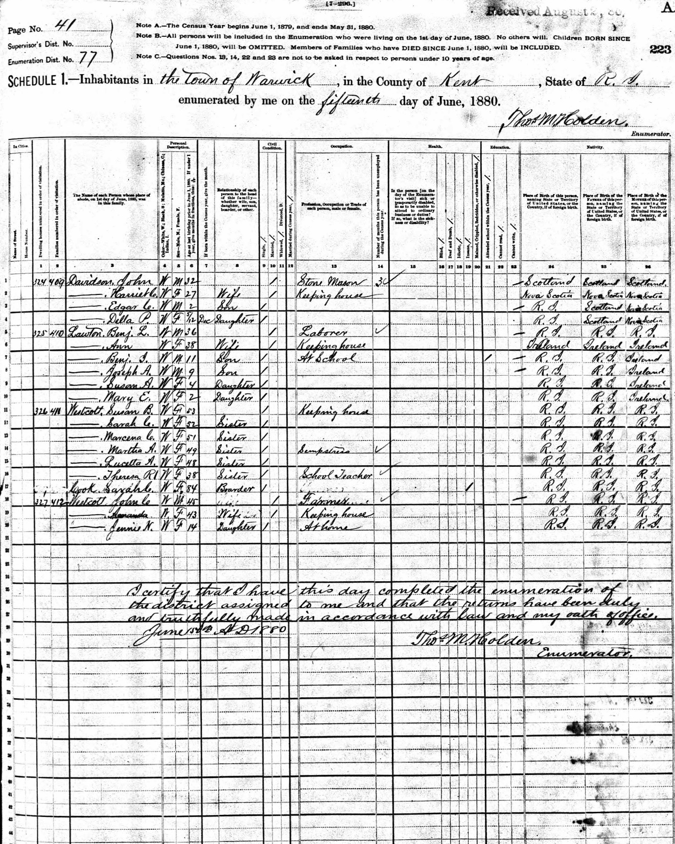
Cook, Sarah C. W/F/84 Boarder Insane
Notes:
In the federal and state censuses in the second half of the century Sarah Crawford Cook is a boarder in Westcott home and is recorded as “insane.”
The family story is that Sarah lived in isolation on the second floor of the Westcott house for most of her 70 years after being “scorned by a lover.” She died in 1882.

Slide 34
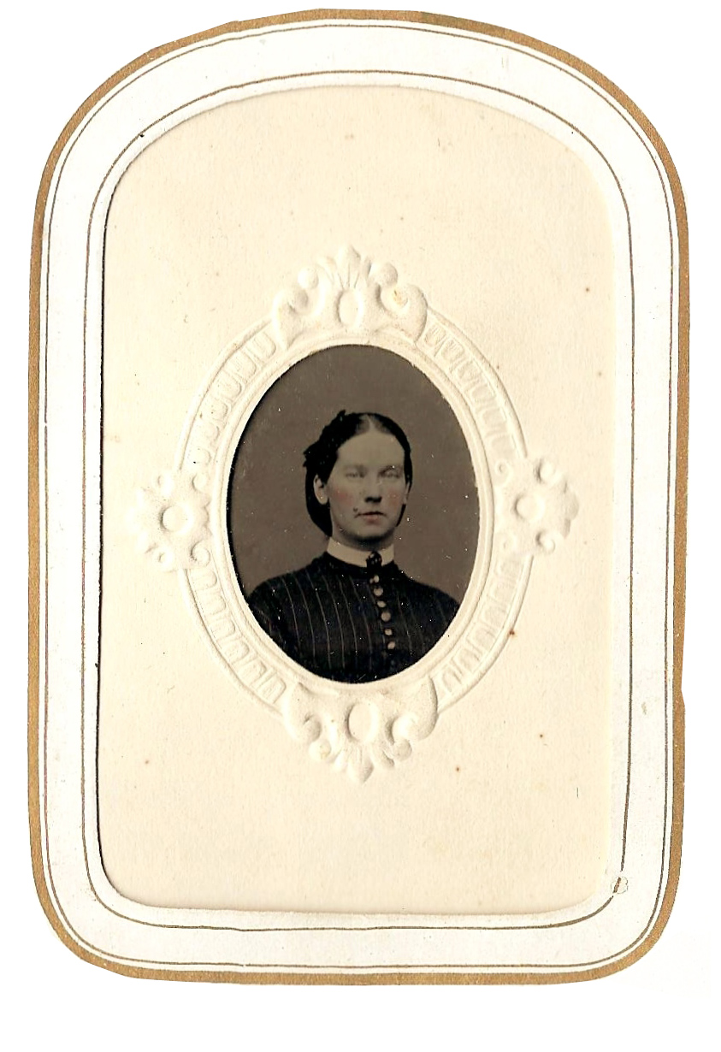
[Westcott], Martha A. W/F/49 Sister Seamstress
Notes:
In the 1880 federal census six of the Westcott sisters are living in the home with the reclusive Aunt Sarah. The oldest sister, Susan, is the head of household, Martha is a seamstress and a younger sister Theresa is a teacher. No occupation is noted for the other sisters, but the family was known locally for rug making and other domestic crafts.

Slide 35
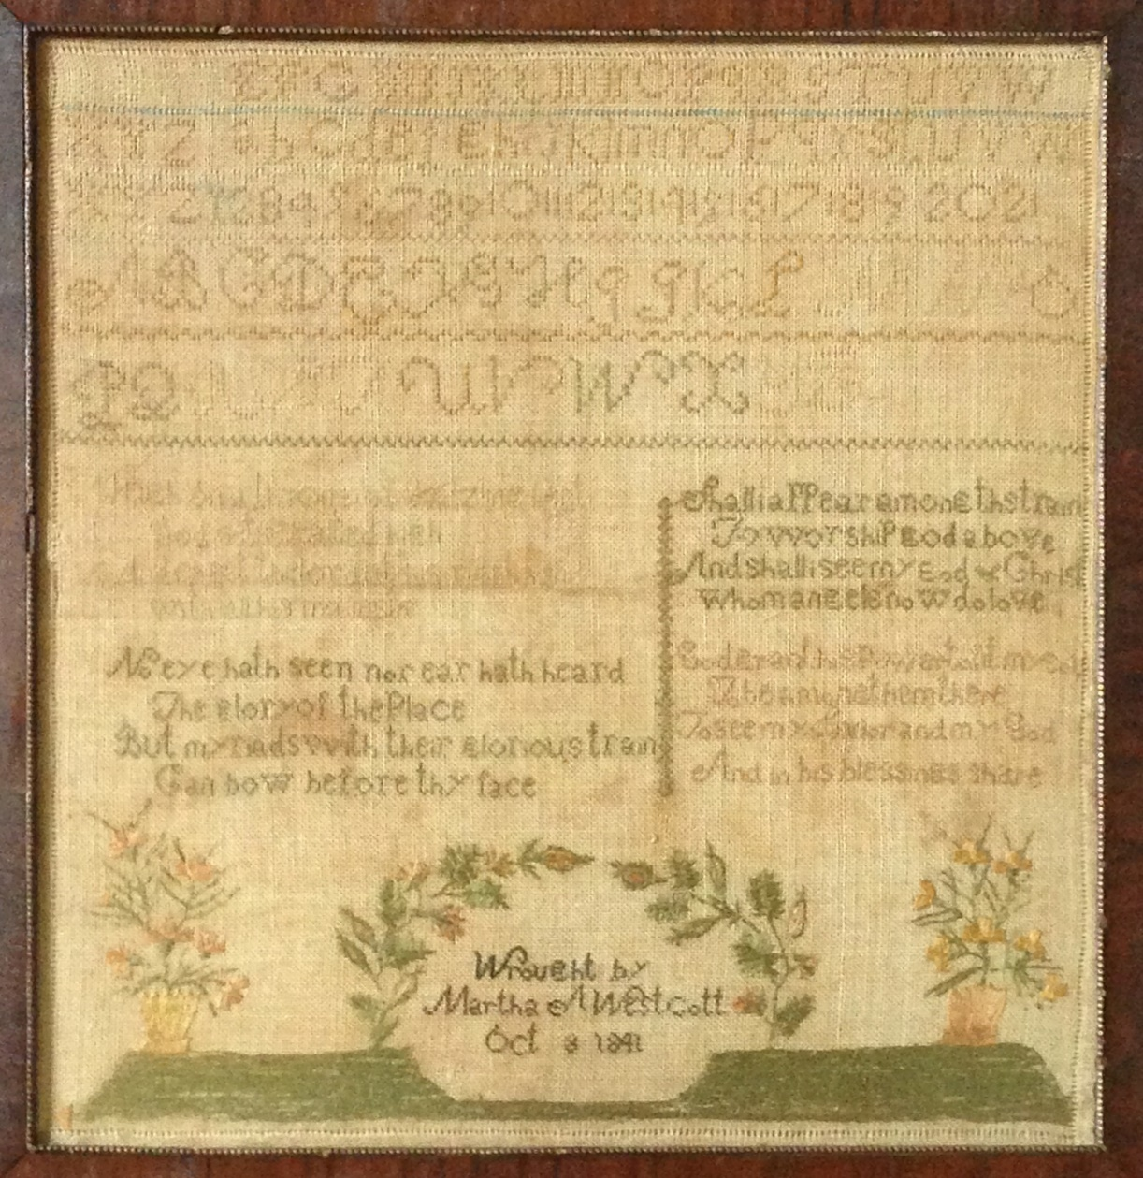
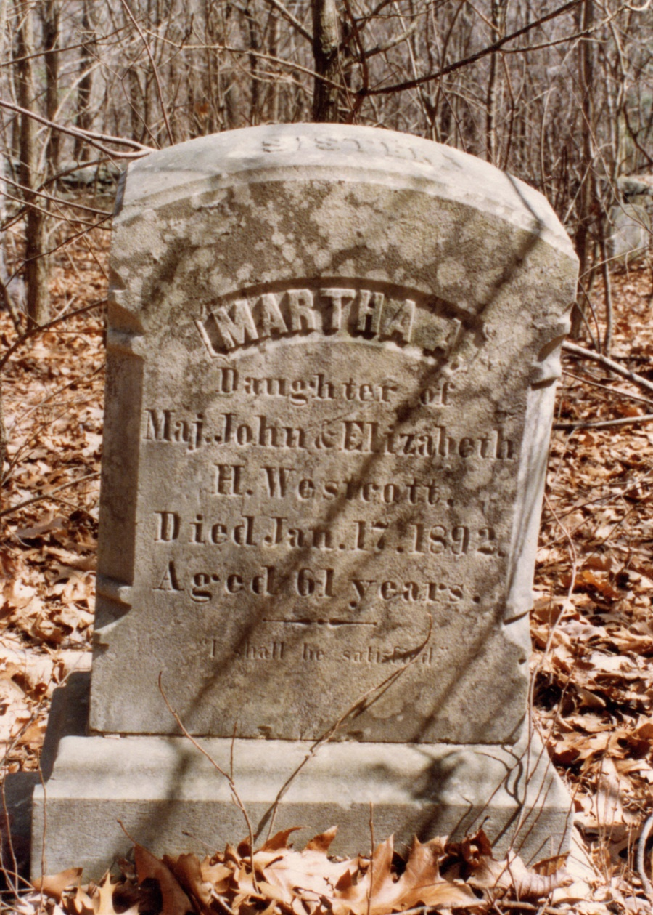
Notes:
Martha died on January 17, 1892. This is her headstone in the General Thomas Westcott Lott.
Cousins Sarah Cook and Sarah Rice and their niece Martha Westcott each made an enduring mark early in life by stitching a sampler. Sarah Rice died early, Sarah Cook died mad, and Martha Wescott lived a quiet life with promise of appearing in that great train and seeing her God and savior. All three remain in Westcott, R.I., buried in the General Thomas Westcott Lot on the hill behind the Westcott Rice House, along with many other Westcotts and Cooks, and perhaps General Thomas Westcott himself.

Slide 36
Three Samplers from Westcott, Rhode Island
Thank You
Notes:
Please be sure to take a look at the three samplers and the other artifacts in the display.
And thank you much.

Slide 37
